Slide 1
Rhode Island
Office of Management & Budget
FFATA Sub-Award Reporting
Data Collection Tools

Slide 2
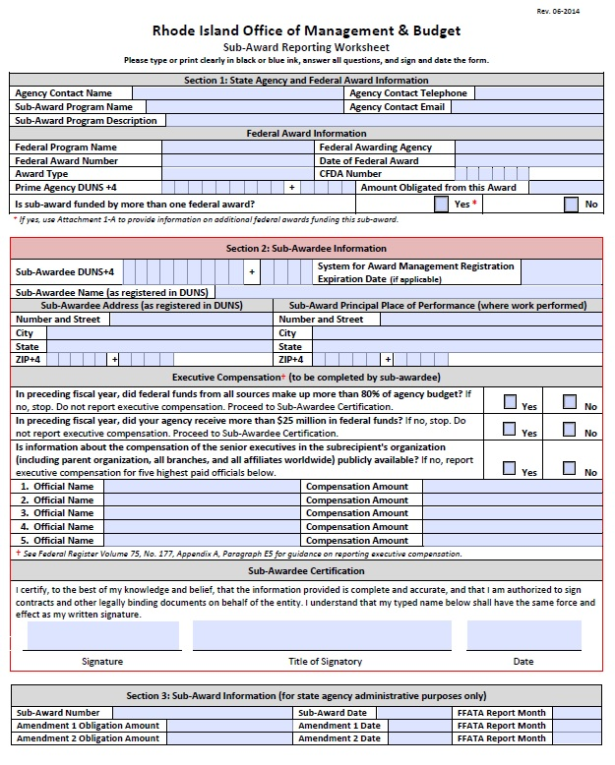
FFATA Sub-Award Reporting Worksheet
PDF fillable form.
As of July 1, 2014, the form is to be completed as part of the contracting process.
State agency must enter contact information and complete Section 1 prior to sending form to sub-awardee.
Sub-awardee must complete Section 2, sign, and return to awarding state agency.

Slide 3
Terminology
FFATA: Federal Funding Accountability & Transparency Act of 2006
FSRS.gov: FFATA Sub-award Reporting System
Prime Recipient: Agency that receives award directly from the federal government.
FFATA Sub-Award: Federal funds awarded to an entity that meets the definitional criteria of a sub-award.

Slide 4
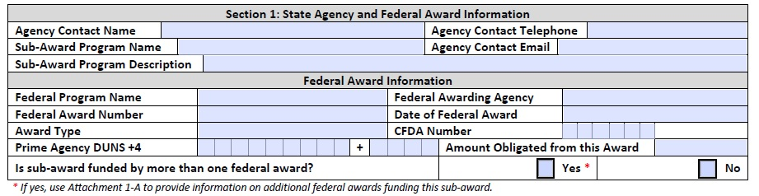
Section 1: State Agency and Federal Award Info
Agency must complete this section before sending to sub-awardee.
NOTE: If sub-award is funded by more than one federal award, agency must also complete FFATA Attachment 1-A and attach to form.

Slide 5
FFATA Reporting Data Elements
Sub-Award Data Elements:
    DUNS Number
    Agency Name
    Obligation Amount
    Project Description
    Principal Place of Performance
    Executive Compensation Information
Agencies must collect and report information in a timely manner (by the last day of the month following the month in which a sub-award was made).
As of July 1, 2014, Agencies will be required to use Sub-Award Reporting Worksheet to collect sub-award data elements.

Slide 6
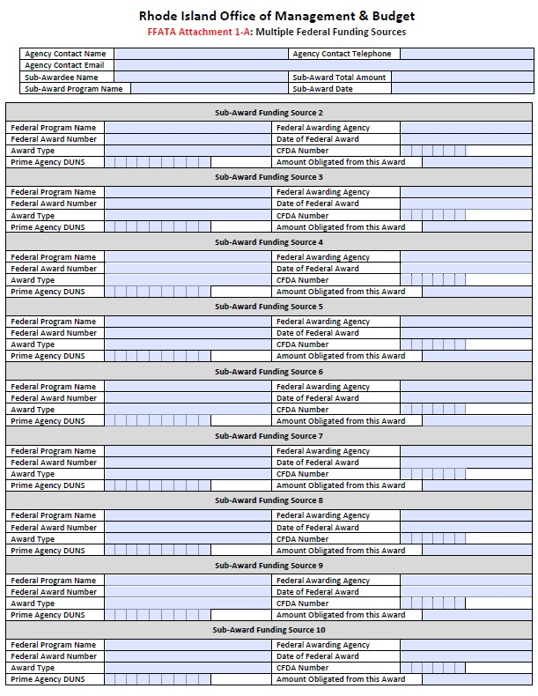
FFATA Attachment 1-A
State agency completes and includes with FFATA Sub-Award Reporting Worksheet if sub-award is funded by more than one federal award.
For each additional funding source, enter the federal program name, awarding agency, award number, award date, award type, CFDA, the amount obligated, and the prime agency DUNS (if different).
The amount obligated from each federal funding source should equal the total sub-award amount.

Slide 7
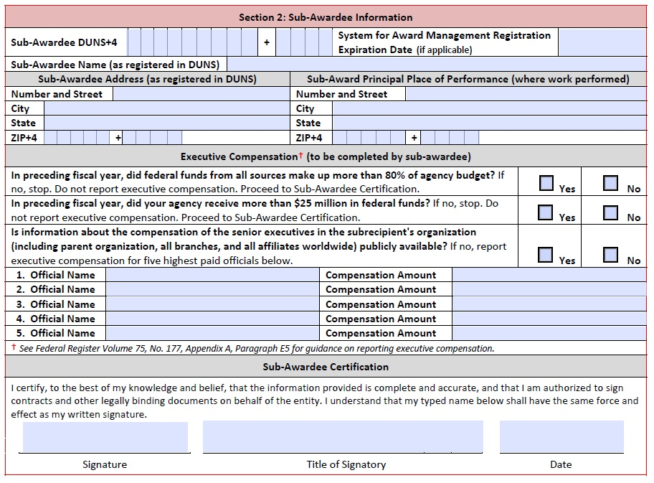
Section 2: Sub-Awardee Information
Sub-awardee completes all fields.
Executive Compensation:
If answer to the 1st and 2nd Executive Compensation questions is “no,” information on highly compensated officers is not required.
If the answer is “no” to the 3rd Executive Compensation question, the sub-awardee must report compensation information for the entity’s five highest paid executives.
Authorized official certifies with signature.

Slide 8
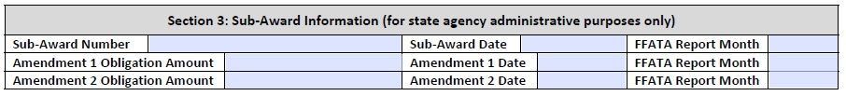
Amendments
Use Section 3 to track when FFATA reports will be due.
Any amendments (modifications) that increase or decrease the sub-award obligation amount must be reported.

Slide 9
Resources
Presentation materials and reporting tools are available for download: http://omb.ri.gov/grants/resources/FFATA.php
For more information, contact:
Laurie Petrone
574-8423
Laurie.Petrone@omb.ri.gov

